Slide 1

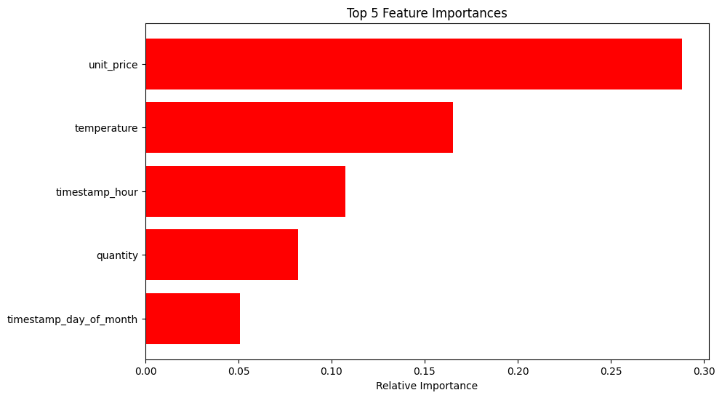
Problem Statement: "Can we accurately predict the stock levels of products on an hourly basis to intelligently procure products from suppliers?“ Model Overview: Type of model: "Random Forest Regressor." Target variable: "Estimated Stock Percentage ('estimated_stock_pct').“
COGNIZANT VIRTUAL INTERNSHIP ON FORAGE
"Stock Level Prediction Model"
Key Findings:
Average MAE: 0.24
A lower MAE indicates higher precision in predictions
It predicts the stock level for a specific product at a given hour, it tends to be within 0.24 units of the actual stock level.
Conclusion:
The stock level prediction model offers a valuable tool for optimizing inventory management and addressing the problem statement.
Recommendations:
- Implement real-time inventory management using model predictions.
Collect additional data to improve model accuracy
- Explore integrating IoT sensor data for more precise predictions.

